Slide 1
ENSE 374, Milestone 2
Space Minds
Anupras Burokas, Ahras Ali, Jack Zhao
Wednesday, Oct. 2

Slide 2
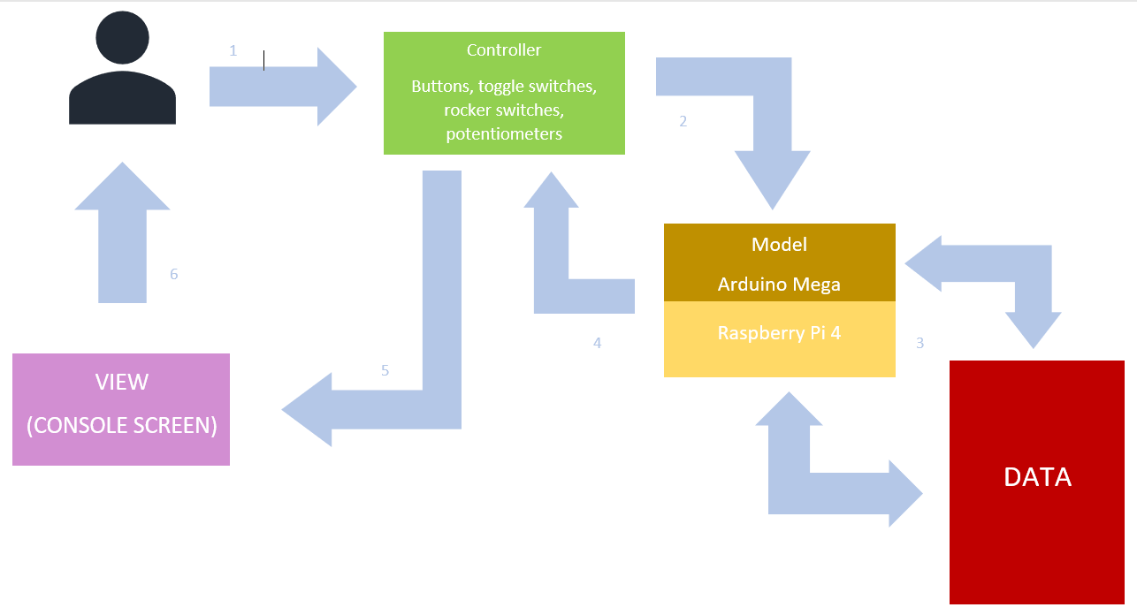
Project blurb & MVC architecture
We are building a NASA imitation console that educates and inspires young minds about the technological advances of space exploration.

Slide 3
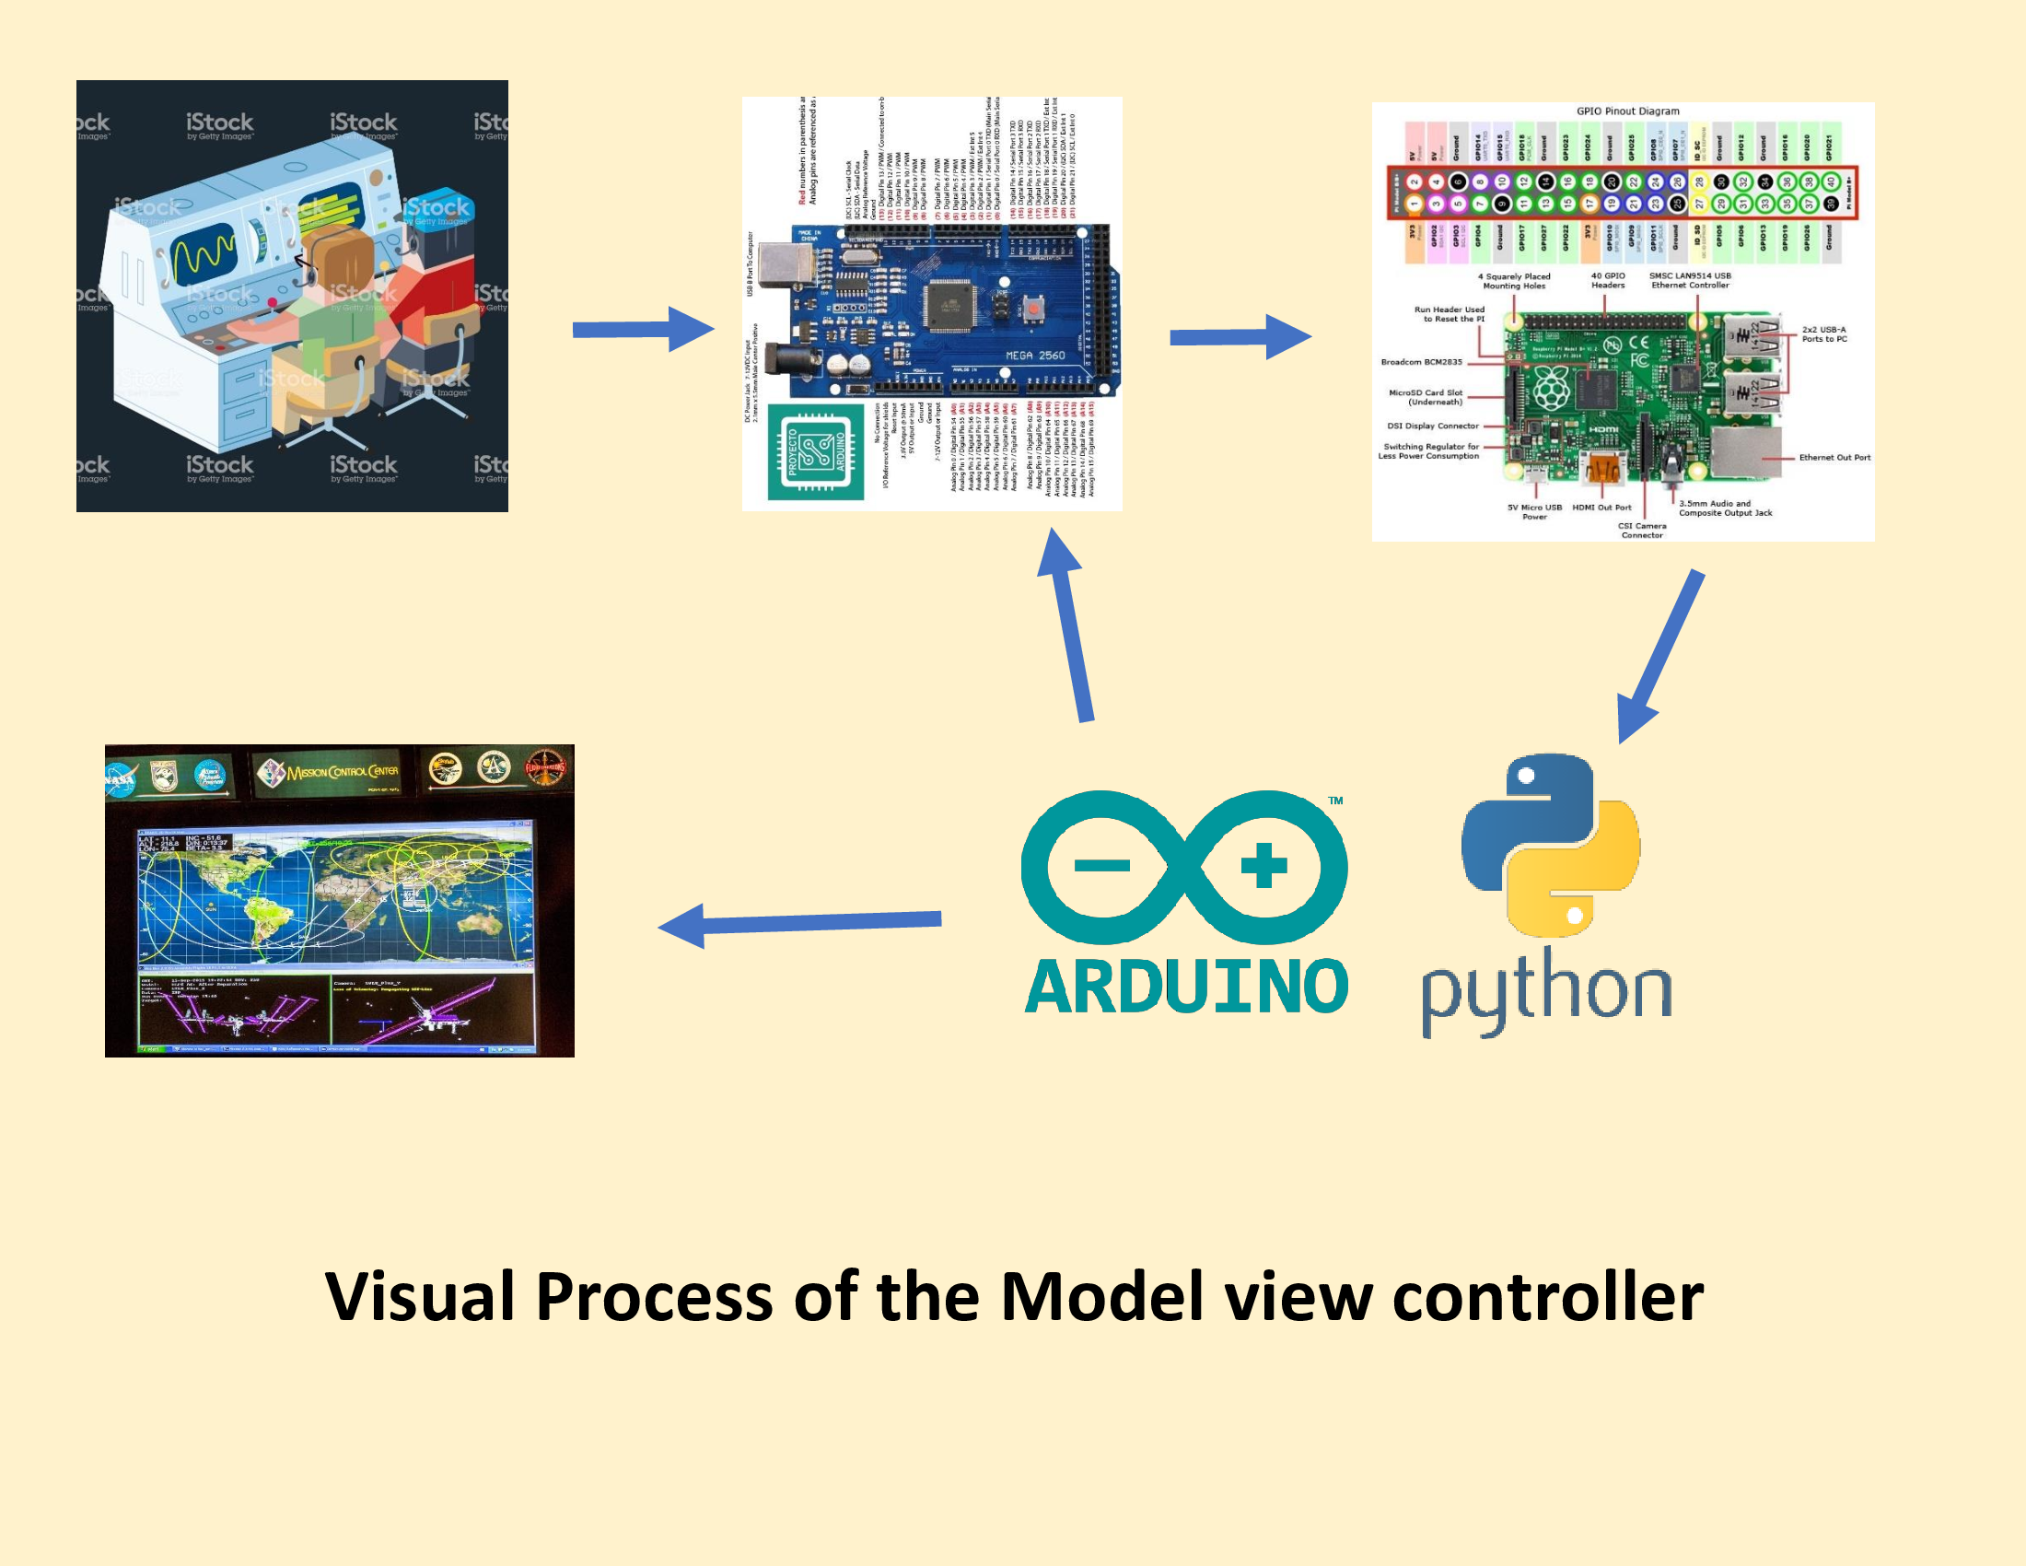

Slide 4
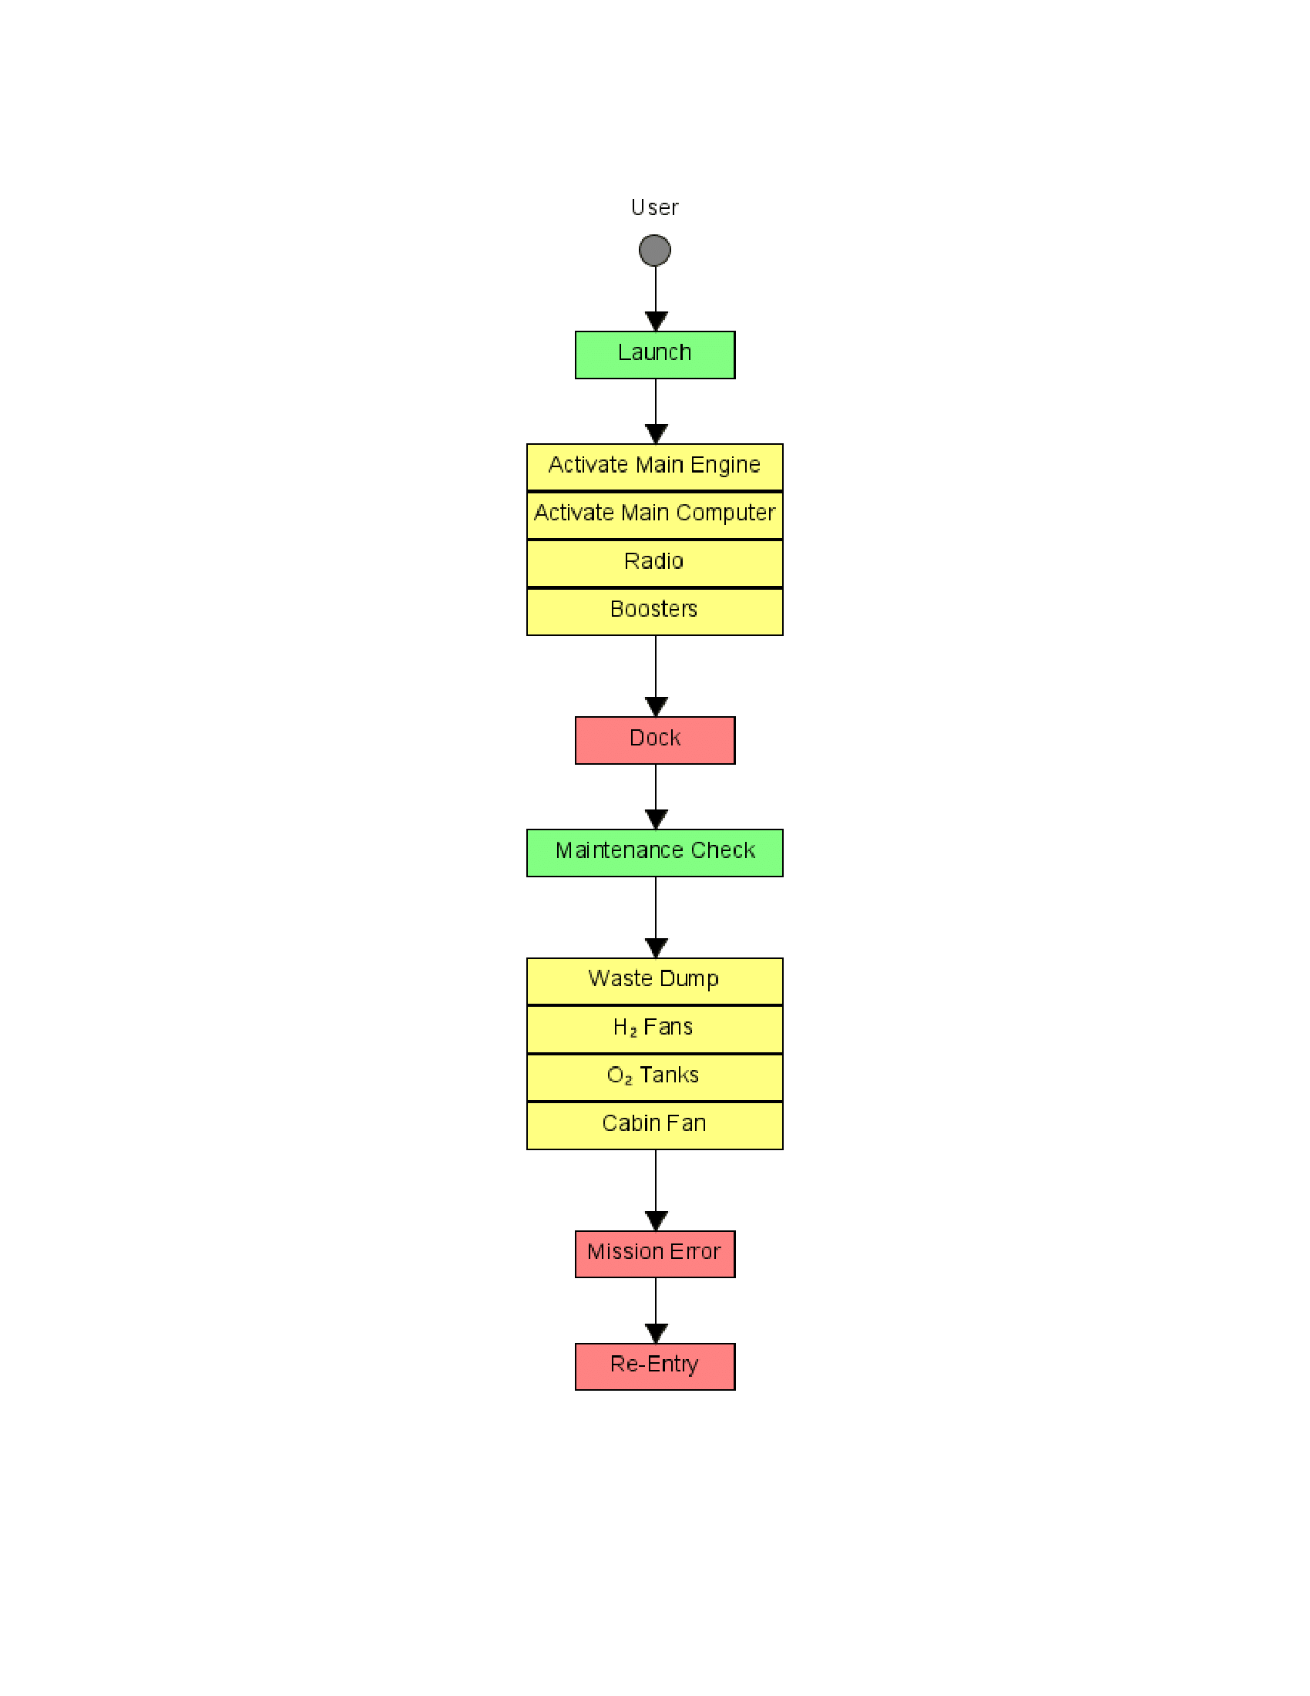
Domain Driven Design, UMLing, & MVP-1
We’re tailoring our UML and code to NASA keeping it very linear

Slide 5
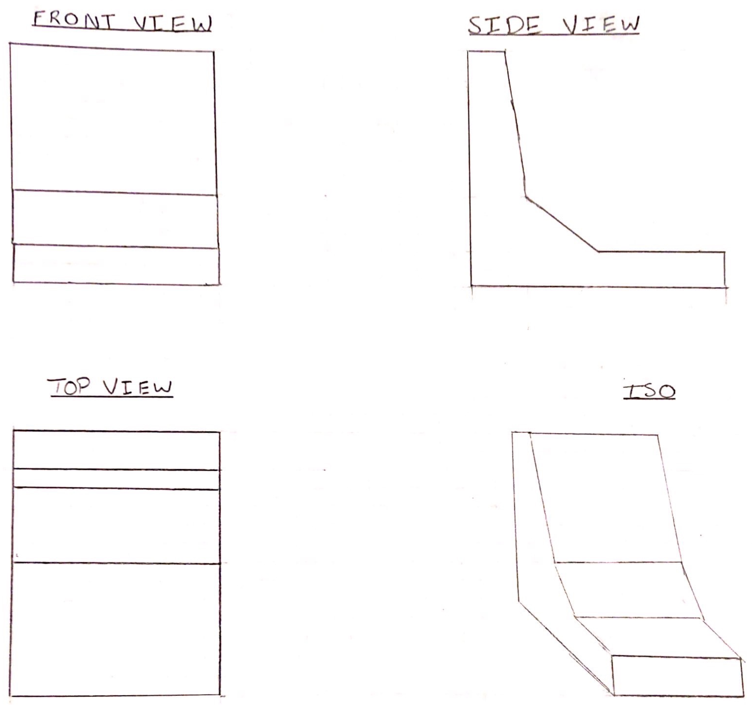
(sort of…)

Slide 6
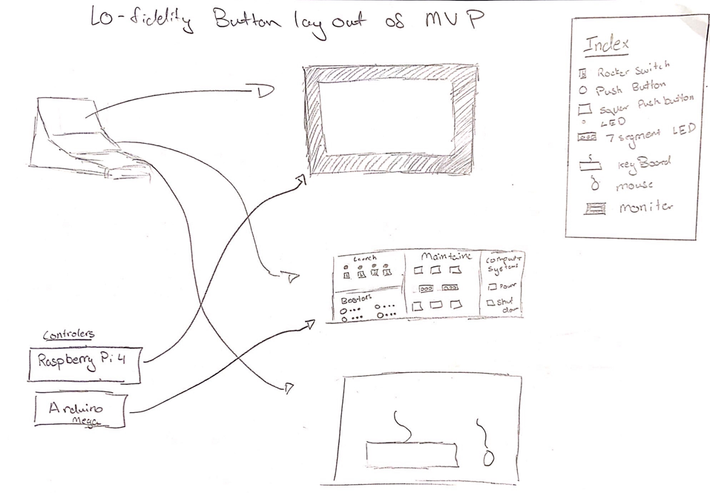
Lo-fidelity prototype
Key Activities:
*Launch
*Flip switches
*Dock
*Joystick + buttons
*Maintenance Check
*Buttons + LED
*Mission Error
*Keyboard + buttons
*Re-Entry
*Buttons + joystick +

Slide 7
Requirements, Kanban & GitHub review
For our FRD we added methodology, some user requirements, and a little bit of functional requirements.
As for changes to our project, we started considering some new designs and changed some dimensions of the console so that we can add new/different features.
Our team’s focus for our first MVP is definitely having the frame built and have the wiring and some coding done.
There will be some barriers to this as our schedule doesn’t line up over the reading week but we have figured out the best compromise to make it work. Another hindrance might be having enough space to build our project; but so far it seems that we can have it built in Ahras’ basement.
We also added some new folders to our GitHub for better organization and we are also trying to upload whatever we think is important or useful; and we are also updating old files if necessary.

Slide 8
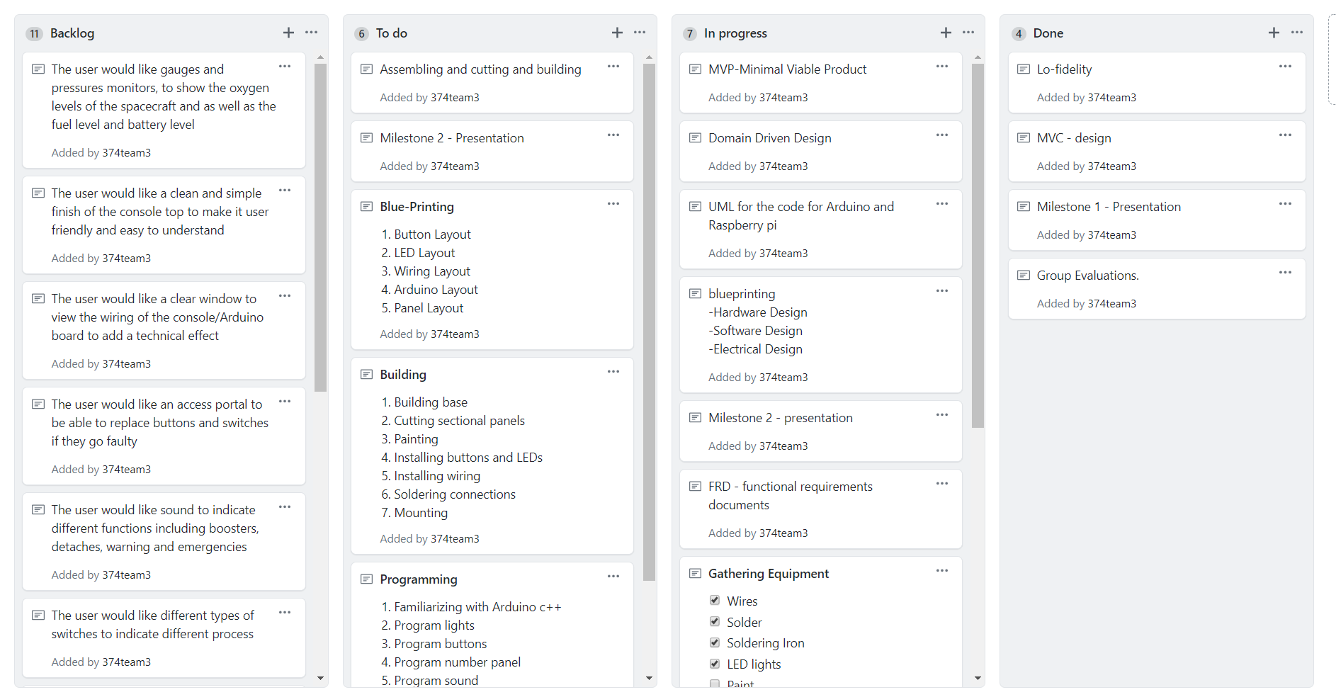

Slide 9
Group reflection
How did you feel about this milestone? What did you like about it? What did you dislike?
We liked the drafting and sketching part as it helped us get a better visualization of our MVP as well as a strong understanding of our scope. This milestone helped us determine the important aspects we require in our project and the process of how we will build and develop our machine
What did you learn about yourself as you collaborated and worked through this milestone?
Try and spend time more efficiently
We also learned that we all have different areas of understanding of our project and how we can combine our expertise
How will you use what you have learned going forward?
We will try to allocate an appropriate amount of time for each task so that we don’t over do certain things and leave some things unfinished
What “stuff & things” related to this milestone would you want help with?
Currently we are on track, we have already talked to Chris from the engineering department as well as Keegan Downie from Electronics, as well as an Engineer Delco Automation.

Slide 10
Questions?

